Slide 1

SOFTWARE TESTING
Manual + Automation java+ selenium with live project
Gunwant Mankar
BE, MTech(CSE), AMIE, MIAEng, MCSI, Purs. LLB.
12Years+ Experience in IT
ISTQB Certified

Slide 2


What is software?
Software is nothing but an Automation.
Software is collection of programs where, it will take input from User. And it will do the process and it will give the Output.
ConnectSoft
Infotech

Slide 3
Drawbacks of Manual Process.
Time Consuming
More Employees
Costly
ConnectSoft
Infotech

Slide 4
Benefits Of Software
It will Reduces the Time.
It will Reduces the Human Resources.
It will save Cost
ConnectSoft
Infotech

Slide 5
What is Testing ?
Test Developed application , whether it is working according to Client Requirement Or not.
Objective of Testing
Ensuring Quality.
Ensuring Correctness.
Ensuring Robustness.
Ensuring Reliability.
Ensuring Product is Bug Free Before Shipment / Release.
ConnectSoft
Infotech

Slide 6
Why Testing is Done ?
Testing is done to assure the Quality.
Quality is defined as Justification of all the Requirements of a Customer in an Application.
ConnectSoft
Infotech

Slide 7
Need for Software Testing
Delivering Quality Software Product.
Satisfying User Requirements.
Making the Software More Reliable.
Reducing Maintenance Cost.
Avoiding Customer Dissatisfaction
ConnectSoft
Infotech

Slide 8
Advantages of Testing.
Quality Product
Client Satisfaction.
More Business.
Bug Free Product.
ConnectSoft
Infotech

Slide 9
Test Qualities.
No Compromise on the Quality
Negative thinking.
Analytical Skills.
Patience.
Communication & Written Skills
ConnectSoft
Infotech

Slide 10
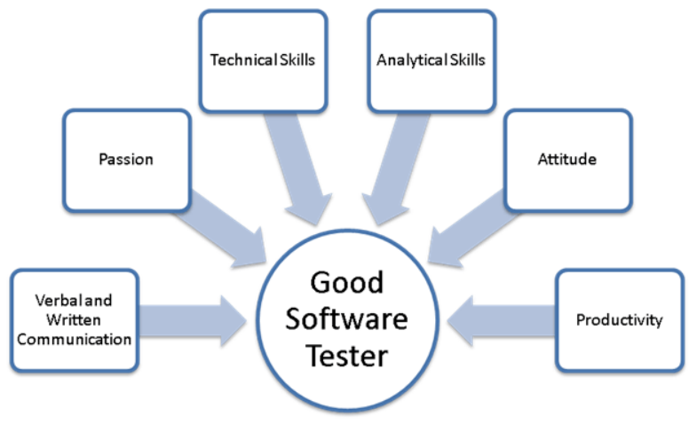
Good Software Tester
ConnectSoft
Infotech

Slide 11
Software Testing
Testing:
To Ensure that whether the application is working as per the Requirements Or not.
Software Testing is a process of verification whether the project will be acceptable to its end-users or not.
There are two types of testing.
Structural (or ) white Box testing.
Functional (or) Black Box testing.
ConnectSoft
Infotech

Slide 12
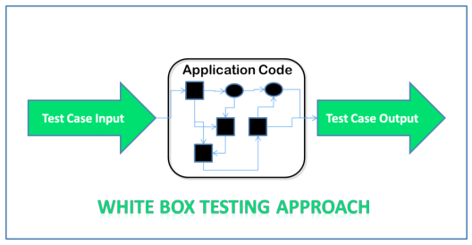
White Box Testing
The testing is based on Knowledge of the internal logic of an application code. Also Known as Glass Box testing.
Internal software and code working should be known for this type of testing.
Tests are based on coverage of code statements , Branches, Paths and conditions.
Unit Testing or Component Testing belongs to white box testing.
ConnectSoft
Infotech

Slide 13
White Box Testing (Cont…)
White Box Testing (also known as Clear Box Testing, Open Box Testing, Glass Box Testing, Transparent Box Testing, Code-Based Testing or Structural Testing) is a software testing method in which the internal structure/design/implementation of the item being tested is known to the tester.
White-box test design techniques include:
Control flow testing
Data flow testing.
Branch testing
Path testing
Statement coverage
Decision coverage
ConnectSoft
Infotech

Slide 14
White Box Testing (Cont…)
Levels Applicable To :
Unit Testing: For testing paths within a unit.
Integration Testing: For testing paths between units.
System Testing: For testing paths between subsystems.
However, it is mainly applied to Unit Testing.
ConnectSoft
Infotech

Slide 15
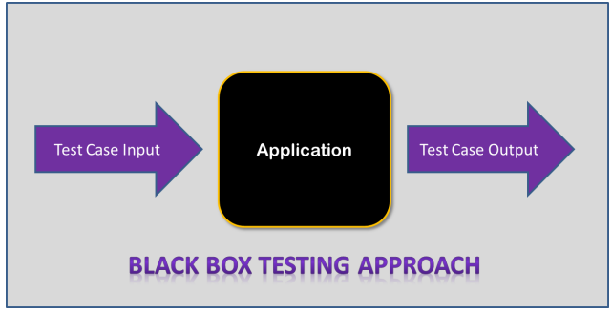
Black Box Testing
Internal System design is not considered in this type of testing.
Test are based on requirements and Functionality.
Other than Unit testing the remaining testing types, belongs to this Black Box Testing.
ConnectSoft
Infotech

Slide 16
Black Box Testing Techniques:
Following are some techniques that can be used for designing black box tests.
Equivalence partitioning.
Boundary Value Analysis.
Cause Effect Graphing
ConnectSoft
Infotech

Slide 17
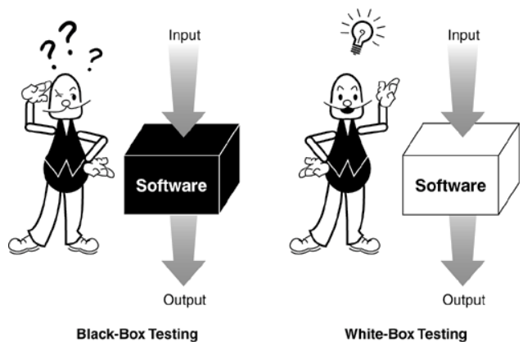
Differences between Black Box and White Box Testing
ConnectSoft
Infotech

Slide 18
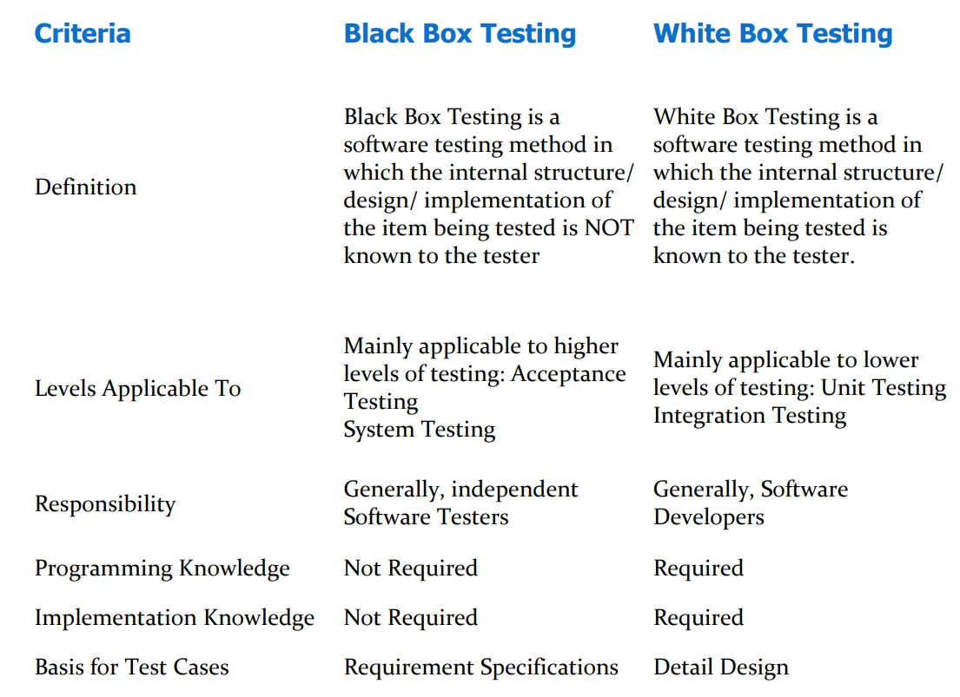
ConnectSoft
Infotech

Slide 19
What is SDLC?
SDLC is a process followed for a software project, within a software organization.
It consists of a detailed plan describing how to develop, maintain, replace and alter or enhance specific software.
The life cycle defines a methodology for improving the quality of software and the overall development process.
ConnectSoft
Infotech

Slide 20
SDLC -Software Development life cycle
Phases in SDLC
Requirements Capturing.
Analysis.
Design.
Coding.
Testing.
Implementation.
Support /Maintenance
ConnectSoft
Infotech

Slide 21
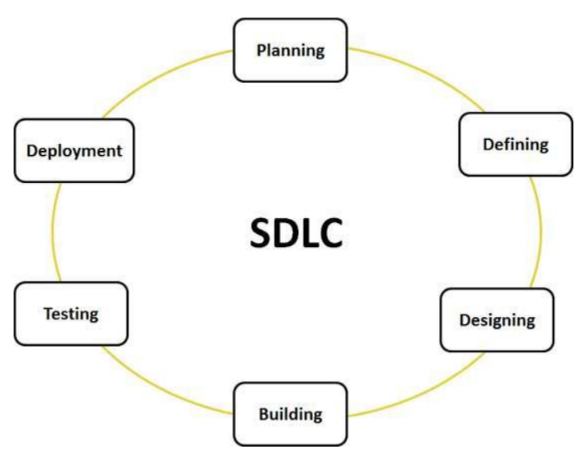
ConnectSoft
Infotech

Slide 22
Stage 1: Planning and Requirement Analysis :
Requirement analysis is the most important and fundamental stage in SDLC. It is performed by the senior members of the team with inputs from the customer, the sales department, market surveys and domain experts in the industry.
This information is then used to plan the basic project approach and to conduct product feasibility study in the economical, operational, and technical areas.
Planning for the quality assurance requirements and identification of the risks associated with the project is also done in the planning stage.
The outcome of the technical feasibility study is to define the various technical approaches that can be followed to implement the project successfully with minimum risks.
ConnectSoft
Infotech

Slide 23
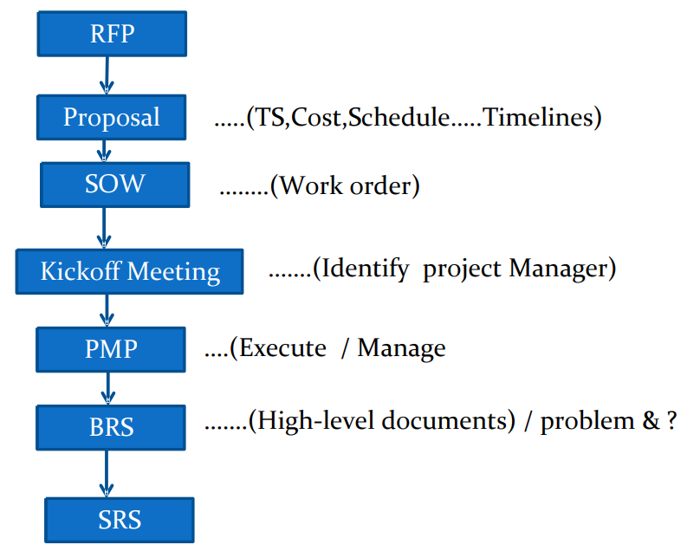
ConnectSoft
Infotech

Slide 24
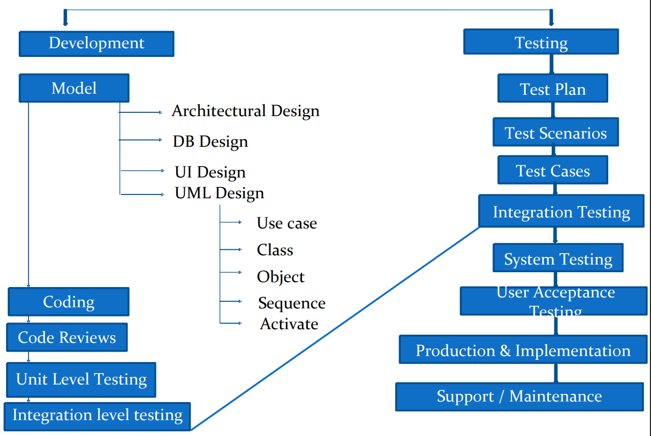
ConnectSoft
Infotech

Slide 25
Request for Proposal – RFP
Client will distribute the RFP to Vendors (Software Companies)
Companies will respond to RFP with their Proposal
Proposal
Contains Technical Solutions, Schedule, Timeline, Resource, cost, Deliverables, value added Services ..etc.
SOW
If client likes the Proposals from any vendor, then they will Sign statement of work With Vendor
ConnectSoft
Infotech

Slide 26
Kick-off meeting
Client will conduct the Kick of meeting with the vendor and Explains the Expectations
PMP
Once the project Manager got Identified then the he/she will prepare the Project Management plan
ConnectSoft
Infotech

Slide 27
BRS – Business Requirement Documents
After high level meeting with the customer they will release Business Requirements Specification.
BRS is a high level Document containing Project Requirement from Customer
SRS – Software Requirement Specification
Person should be a domain Expert or Functional Expert we will be eligible to Convert the BRS into SRS
ConnectSoft
Infotech

Slide 28
Development
Based on approved SRS software architect or Technical lead will design the model of the project.( prototype or blue print).
Model Contains
1. Architectural Design.
2. Database Design.
3. User Interface Design.
4. All UML Diagrams.
a. Use case .
b. Class
c. Object
d. Sequence
e. Collaboration
f. Deployment Review and approval of Design Document.
Review and approval of Design Document.
ConnectSoft
Infotech

Slide 29
QA & Testing
Test Manager of Test lead (assigned by TM) shall study the approval SRS and Prepares the Test Plan for the project based on the project Management Plan.
Review and approval of the Test Plan.
Based on approved SRS and design Documents test Engineer are going to Identify the required Test Scenarios for the project
Review and approval of the Scenarios.
Test Engineers are going to prepare the Test Cases for all identified scenarios Based on FRS – Functional Requirement Specification
Review and approval of test case
ConnectSoft
Infotech

Slide 30
Development
Developers are going to convert the logics specified in design documents programs as per chosen programming language and they will release code.
Perform Code Review.
Once Particular unit of code as Reviewed and approved perform unit testing.
Once Unit testing is approved developers will integrate the units and release the Build for testing
QA & Testing
Perform Integration Testing.
Once Integration testing is approved perform system Testing.
Perform Retesting and Regression testing.
ConnectSoft
Infotech

Slide 31
Development
Developers are going to fix the Defects reported by testing teams.
QA & Testing
Once system testing is approved then the application will be release for UAT.
Perform UAT (User Acceptance Testing).
Once UAT is approved release the application for production.
Once production is ready perform the installation testing.
Once installation testing is approved , Implement the developer software into Customer environment and provide user training.
Provide Support to the Customer for any problems issues for any future Enhancements.
ConnectSoft
Infotech

Slide 32
Manual Testing
Manual Testing , Testers manually execute test cases without using any automation tools. Manual testing is the most primitive of all testing types and helps find bugs in the software system.
Any new application must be manually tested before its testing can be automated. Manual testing requires more effort, but is necessary to check automation feasibility.
Manual Testing does not require knowledge of any testing tool. One of the Software Testing Fundamental is "100% Automation is not possible".
This makes Manual Testing imperative.
ConnectSoft
Infotech

Slide 33
Goal of Manual Testing
The goal of Manual Testing is to ensure that the application is error free and it is working in conformance to the specified functional requirements. Test Suites or cases , are designed during the testing phase and should have 100% test coverage.
It also makes sure that reported defects are fixed by developers and re-testing has been performed by testers on the fixed defects. Basically, this testing checks the quality of the system and delivers bug-free product to the customer.
ConnectSoft
Infotech

Slide 34
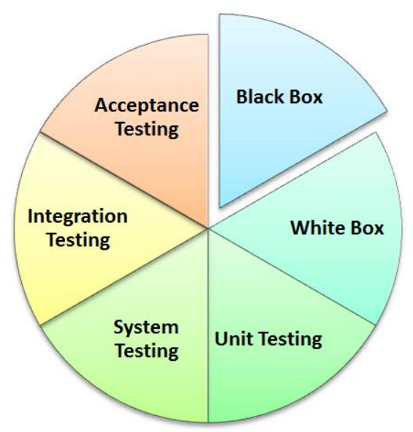
Manual Testing types
Manual Testing Types. In fact any type of software testing type can be executed both manually as well using an automation tool.
ConnectSoft
Infotech

Slide 35
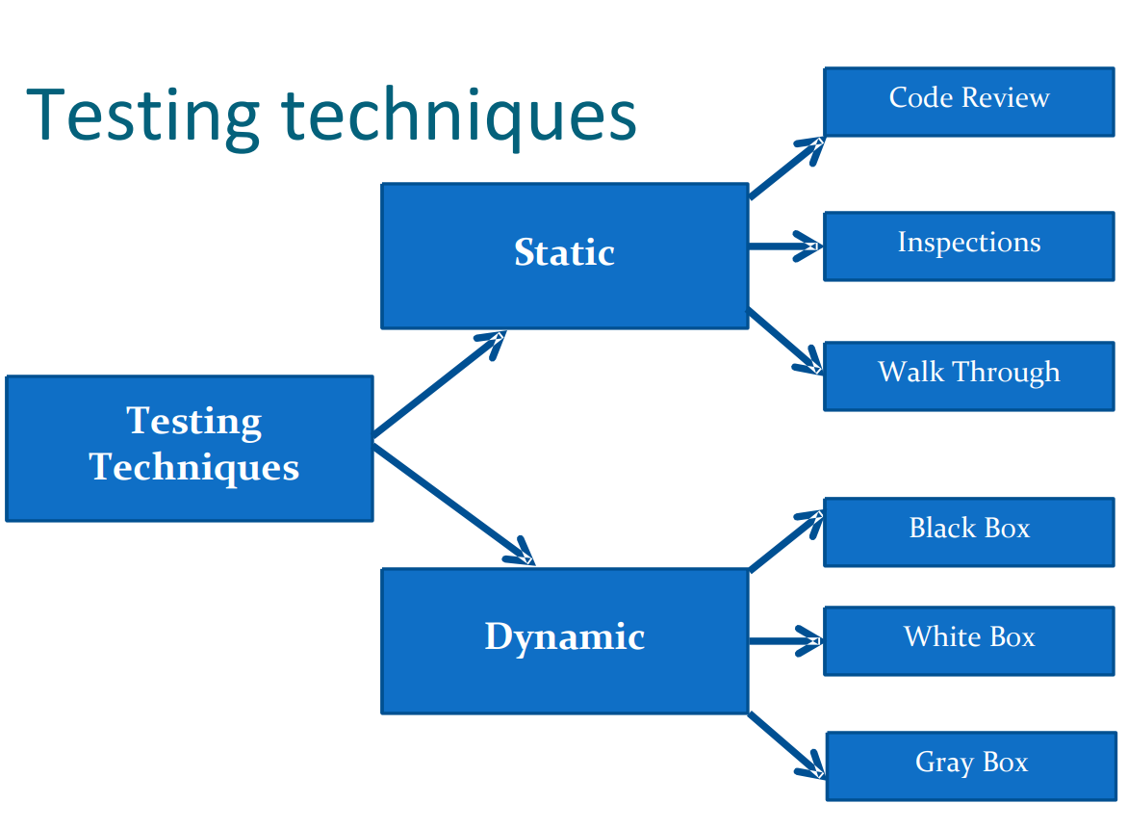
ConnectSoft
Infotech

Slide 36
Testing Techniques:
Testing Techniques can be classified into two categories.
Static Testing.
Dynamic Testing.
Static Testing
Application checking is carried out without Executing the application is called as static testing.
It is Inspection of software artifacts , such as Requirements specification, design and code.
It is done by the following Methods.
Review
Inspection.
Walk through
ConnectSoft
Infotech

Slide 37
Testing Techniques:
Dynamic Testing:
Application checking is done by executing the application is called as Dynamic Testing.
Dynamic testing are classified into three Categories.
white Box testing.
Black Box testing.
Grey Box testing.
ConnectSoft
Infotech

Slide 38
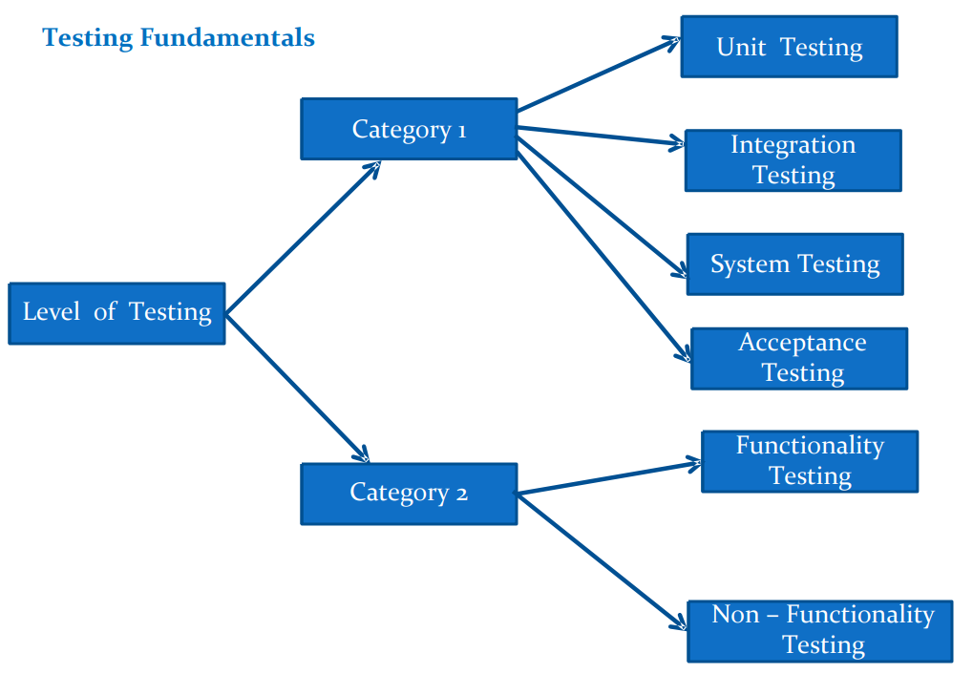
ConnectSoft
Infotech

Slide 39
Levels of testing:
There are Four Levels of Testing
Unit Level Testing.
Integration Level Testing.
System Level Testing.
User Acceptance Testing.
ConnectSoft
Infotech

Slide 40
Unit Level Testing.
Testing of single program, module or unit of Code.
Deliverable: Software Unit is ready for testing with other system components.
ConnectSoft
Infotech

Slide 41
Integration testing:
Integration testing is a process of combining the modules and testing the data Flow between the modules.
Integration testing verifies that the combined Unit function together Properly.
This can facilitate finding problem that occur at interface or communication between the individual components.
It is also referred as Assembly testing.
It is divided into two Types.
Incremental integration testing.
Non – Incremental integration testing
ConnectSoft
Infotech

Slide 42
Incremental integration testing:
Incremental integration testing is a process of testing in which each unit is Integrated one at a time into the system.
The data flow between the modules is tested as soon as a new module is integrated.
This process consists of systematically combining the Unit tested module one by one and testing combined modules.
Incremental Integration testing is divided into two types.
Top – Down Testing.
Bottom – Up Testing
ConnectSoft
Infotech

Slide 43
Top - Down Testing
Top –down testing is a process of incrementally adding the modules from parent to Child and the data flow between the modules.
This process works downward through the software hierarchy (Top – to - Bottom).
It emphasize on interface testing.
Bottom – Up testing.
Bottom – up testing is a process of incrementally adding the modules from child to parent and test the data flow between the modules.
It emphasize on module Functionality.
ConnectSoft
Infotech

Slide 44
Non – Incremental Integration testing.
Non – incremental integration testing is a process of testing the product by Integration every unit, all at a time into system and testing the data flow between the modules.
This Method can be used to save time in the integration process.
It is also called as Big Bang method.
ConnectSoft
Infotech

Slide 45
System Testing
System testing verifies whether the entire application is working according to the Software requirements.
It is also Referred to as product testing and End – to – End testing.
System Testing Involves some or all of the tests listed below.
Compatibility testing.
Usability testing.
Performance testing.
Security Testing
ConnectSoft
Infotech

Slide 46
Acceptance Testing.
Acceptance testing is a process in which testing of the application is done by The end – user or client.
The Client tests whether the application meets the Requirements given by him.
It is classified into two types.
Alpha testing.
Beta testing
ConnectSoft
Infotech

Slide 47
Acceptance Testing.
Alpha Testing.
Alpha testing is done by potential user / customer or an independent testing team at the developers site along with the developer or testers.
It is done before Beta testing.
Beta Testing.
Beta testing is done by potential user / Customer or Independent testing team at the Customers real time environment without any developer or tester involvement.
It is done before releasing the product to the market.
ConnectSoft
Infotech

Slide 48
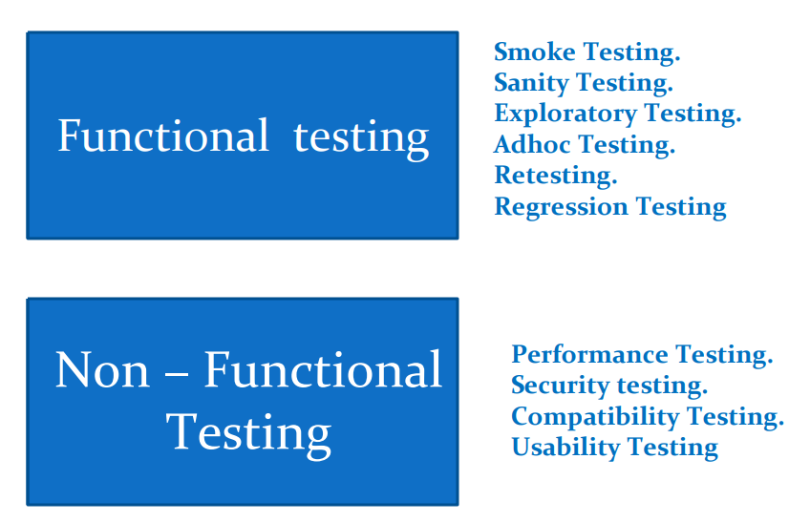
Testing Types.

Slide 49
Smoke /Build Verification / Integration Testing
Smoke testing is a test done before application goes into the actual testing phase.
The tester touches all area of the application without getting in too deep.
The test reveals any simple failure and ensure that the system is ready for Further Testing.
Example:
Smoke test is done to check whether the link or Button does same action. If the Answer is ‘NO’ the condition fails.
ConnectSoft
Infotech

Slide 50
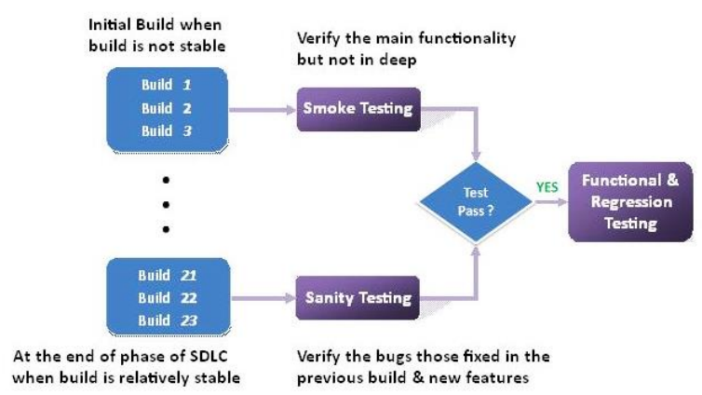
Sanity Testing:
A Sanity Working test is used to determine a small section of the application is still after a minor change.
Sanity tests is usually unscripted.
ConnectSoft
Infotech

Slide 51
Usability Testing :
How simple customer can browser the website or user Friendliness.
Usability Testing is done to test the user Friendliness of the software.
The following areas are tested for Usability
Keyboard & Mouse Operations.
Spelling & Grammatical Mistakes.
ConnectSoft
Infotech

Slide 52
User interface (GUI) Testing.
Verifying the user interface of the application means how the frontend design, Font color, test format, Labels, background foreground …etc.
This is the process of verifying the look and feel environment of the application.
ConnectSoft
Infotech

Slide 53
Functional Testing :
In functional testing the application tested for functional requirements.
Different types of input (test data) are given for testing the Functionality of the Component.
Re - Testing
Reproduce the same test case to verify whether the bug has been fixed or not
ConnectSoft
Infotech

Slide 54
Regression Testing:
Regression Testing is retesting the application just to make sure that the bug has Been fixed and its impact on the Rest of the application.
It is divided into three testing.
Unit Regression Testing.
Re- executing the same test cases on particular unit or Modules due to the Requirements change
Regional Regression testing.
Re- executing the same test cases in two or three modules due to Requirement Change.
Full Regression testing
Re – executing the test cases in all modules due to a Requirement change
ConnectSoft
Infotech

Slide 55
Database Testing.
Two Type of errors that may occur in web application.
Data integrity: missing or wrong data in table.
Output Error: Error is writing , editing or reading operation in the table.
ConnectSoft
Infotech

Slide 56
Compatibility Testing
Compatibility testing is a process of testing the functionality of an application On different hardware and software environments.
Example:
Test the application on different operating system such as windows all version, Linux and unix.
Test the web application on different browsers such as internet explorer, Firefox, Netscape navigator and opera.
ConnectSoft
Infotech

Slide 57
Adhoc Testing.
Adhoc testing is a commonly used term for software testing performed without planning and documentation.
The tests are intended to be run only once, unless a defect is discovered.
Testing carried out informally.
No formal test case preparation takes place.
Ad-hoc testing is not structured.
Types of adhoc testing
Buddy testing.
Pair testing
Monkey testing
ConnectSoft
Infotech

Slide 58
Exploratory testing
Exploratory testing is an approach of software testing where there is simultaneous Exploring the application, prepare the design and test execution.
When performing this test there are no exact expected results, the test decides What be verified.
It is done when requirements are incomplete or there is a lack of time.
Ad-hoc testing is apart of exploratory testing where the test is run once, unless Defect is discovered.
ConnectSoft
Infotech

Slide 59
Security testing
Security testing is a process of testing an application/product how well it is protected from unauthorized entries.
It is used to find out all the potential loopholes and weakness of the system.
Through this testing we can prevent the loss/theft of highly sensitive information From outsider.
It ensure that the system and application used by the organization are secure and not exposed to any type of attack.
ConnectSoft
Infotech

Slide 60
Recovery Testing
Recovery testing is a process of testing the application in order to check how well the application recovers from any type of crash or hardware failure.
It is tested for the systems ability to recover at varying degrees of failure.
ConnectSoft
Infotech

Slide 61
Installation /un installation testing.
Installation testing is defined as test which occurs outside the development Environment.
This test is performed whenever a full, partial or upgrades of the application are Installed/uninstalled.
It is also referred to as implementation testing & software deployment.
ConnectSoft
Infotech

Slide 62
Performance Testing.
Performance testing is a group of tests which the test following aspects.
Response time.
Execute time.
Volume.
Scalability.
ConnectSoft
Infotech

Slide 63
Types of performance Testing
The different types of performance tests are as follows
Load Testing
The application /product is tested again fixed number of users in order to find Out the stability and response time of the product.
Stress Testing
Stress testing is done to evaluate if the application is stable at peak load. i.e beyond the Limits of its specified requirements.
Volume Testing
Volume testing is done to test stability the system by processing Huge amount of data.
Soak Testing
Soak testing is done by application signification load over an extended period of time to discovered how the system behaves ..
ConnectSoft
Infotech

Slide 64
SDLC Models
Waterfall model.
Increment model.
Prototype model.
Spiral model.
Rad Model.
V – Model.
Agile Model .

